Slide 1

EAST IDAHO
ANNUAL PARTNER CONFERENCE
BUILDING HEALTHY COMMUNITIES TOGETHER
APRIL 19, 2024

Slide 2

BUILDING HEALTHY COMMUNITIES TOGETHER
Morgan Wilson, Chief Development Officer, The Idaho Foodbank
Kelsey Cooper, Community Health Coordinator, The Idaho Foodbank

Slide 3

TOP HEALTH NEEDS IN EASTERN IDAHO
Behavioral Health
  Mental health, suicide, substance abuse
Access to Healthcare
  Unaffordable, inaccessible
Chronic Disease
  Obesity, diabetes, prevention of chronic disease

Slide 4
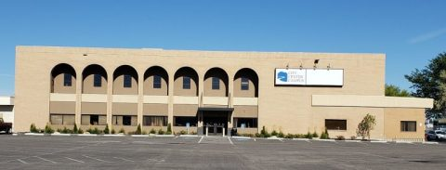
CITY CENTER PANTRY - POCATELLO

Slide 5

MOBILE MEDICAL UNITS & PANTRIES

Slide 6
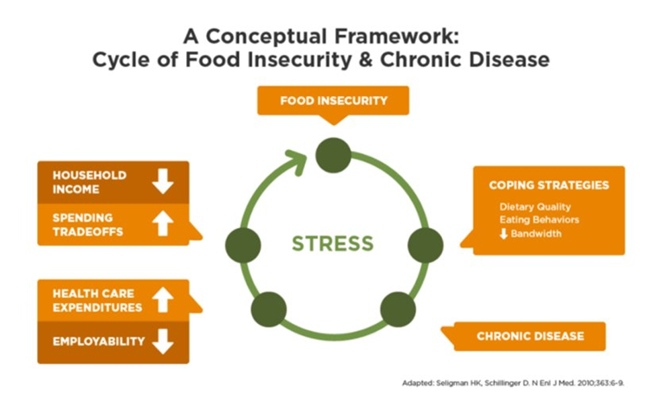
INTERRUPTING CYCLES OF HUNGER

Slide 7
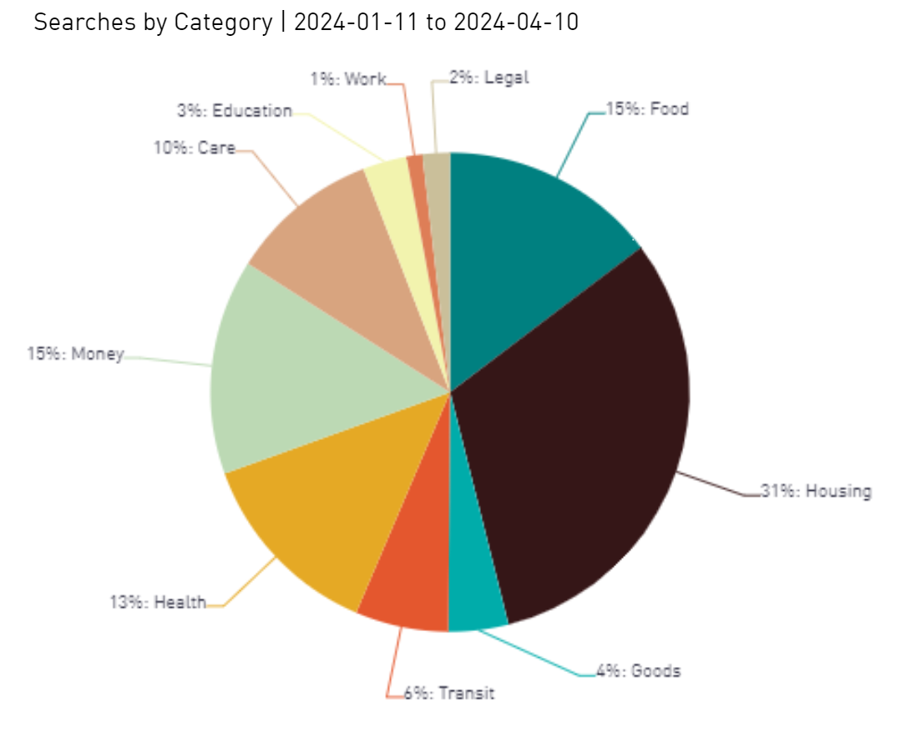
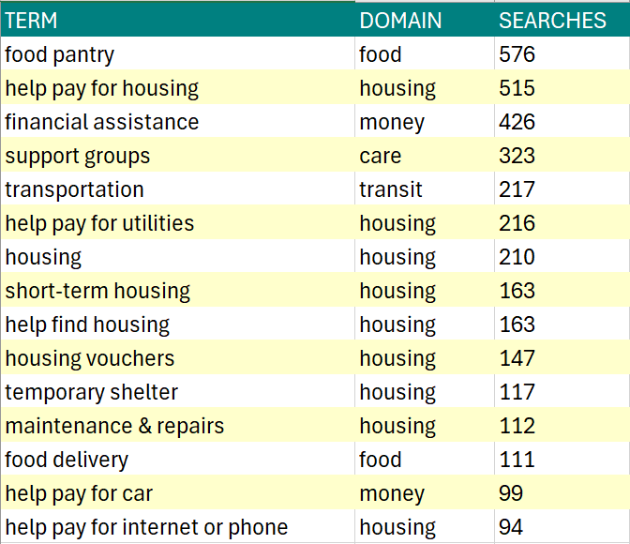
MONITORING NEEDS – FINDHELPIDAHO.ORG

Slide 8

WHO ARE OUR NEIGHBORS?

Slide 9

WHO IS ALICE? A DATA-DRIVEN APPROACH
Shantay Bloxham, CEO, United Way of Southeastern Idaho

Slide 10


Slide 11

Meet ALICE –
Essential, Working, Struggling
ALICE: Asset Limited, Income Constrained, Employed

Slide 12


TEAMING UP FOR: A.L.I.C.E
Notes:
https://www.youtube.com/watch?v=W4XLr8yPL4E

Slide 13

United Way ALICE Project
                600 United Way partners across the country
                Research-based information that increases a better understanding of who is struggling in our communities

Slide 14


ALICE: Caught in the Crosscurrents of Competing Forces
MIGRATION
JOB DISRUPTION
INFLATION
WAGE INCREASES
PANDEMIC ASSISTANCE

Slide 15

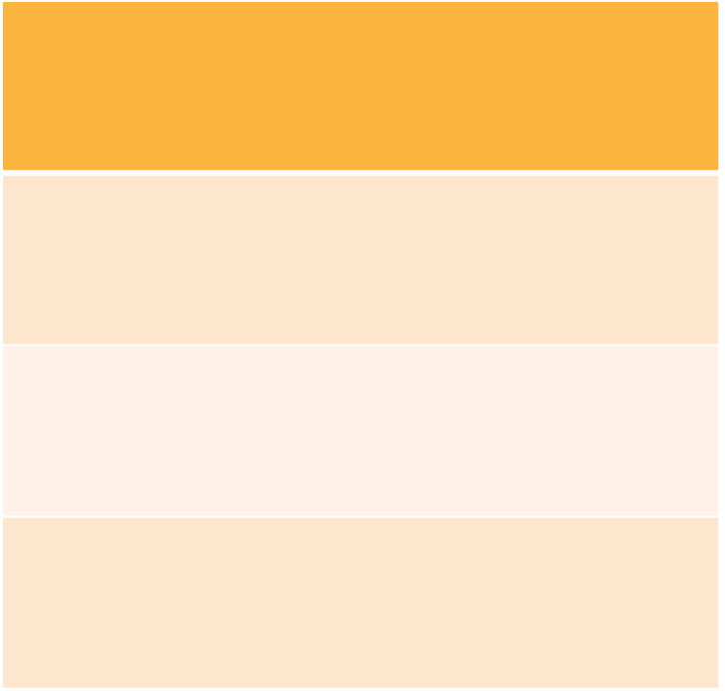
Demographics of Households in Hardship
Highest % Hardship
Lowest % Hardship
Single-Female-Headed (with children) Households
80%
Married (with children) Households
21%
Households Under 25
75%
Households 25 to 44 Years Old
29%
Households Over 65 Years Old
42%
Single-Male-Headed (with children) Households
39%

Slide 16
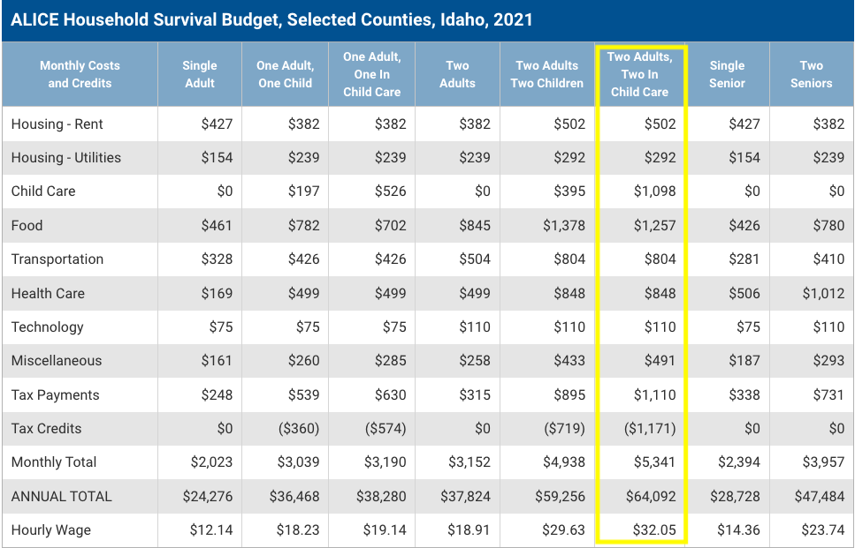

Slide 17

How Can the United for ALICE Project Data Help You
Visit UnitedForALICE.org/Idaho to dig deeper into the data.
Encourage the use of this
data to create change.
Build awareness.
https://www.unitedforalice.org/framework/ALICE-EVD

Slide 18

TEAMING UP FOR: A.L.I.C.E
Notes:
https://www.youtube.com/watch?v=W4XLr8yPL4E play at 58 seconds
Dashboard and website demo

Slide 19

REGIONAL & PARTNER IMPACT REPORTS
Randy Ford, President & CEO, The Idaho Foodbank

Slide 20
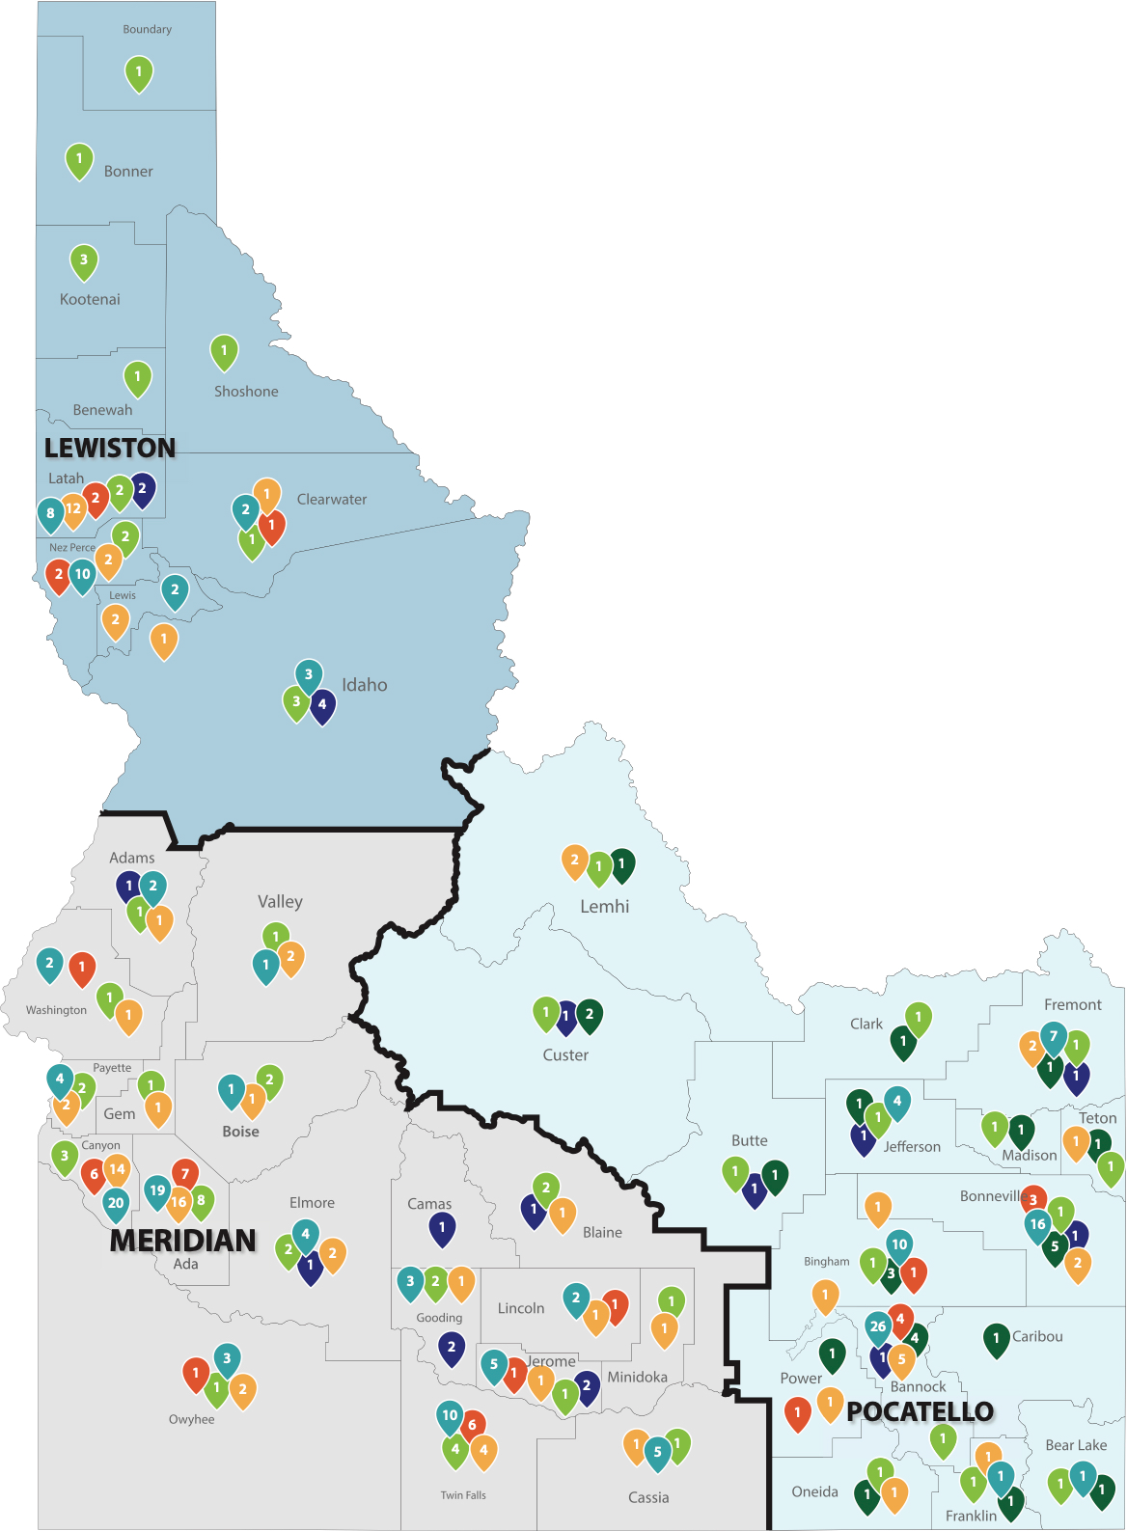
PARTNERING STATEWIDE
In Fiscal Year 2023*:
28,616,494 pounds distributed statewide
86% food considered nutritious
88% food donated to The Foodbank
440+ community distribution partners statewide
*The Idaho Foodbank's Fiscal Year 2023 ran from May 1, 2022 – April 31, 2023.

Slide 21
THE COST OF FOOD
{Pandemic begins March of FY20}

Slide 22
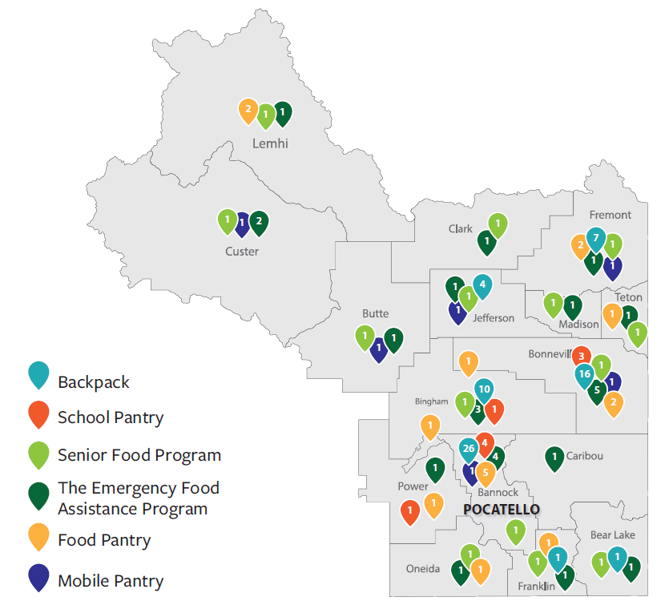
SOLVING HUNGER IN E IDAHO
In Fiscal Year 2023*:​
6,993,915 pounds distributed in E region
46 community partners
16 counties served
57,483 people served (monthly average)
7,953 volunteers provided 16,115 hours of service
​
*The Idaho Foodbank's Fiscal Year 2023 ran from May 1, 2022 – April 31, 2023.

Slide 23

PARTNER IMPACT REPORTS
Kia Shaw, Eastern Idaho Branch Manager, The Idaho Foodbank

Slide 24
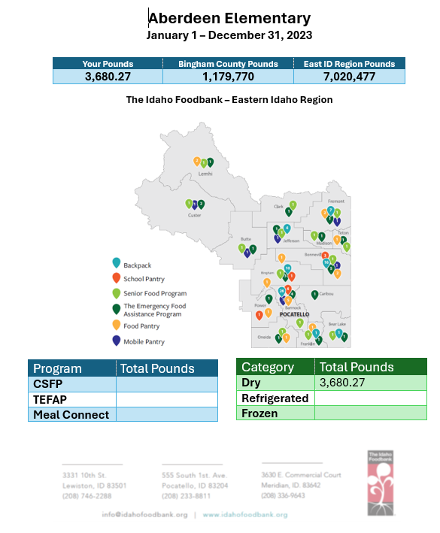
PARTNER IMPACT REPORTS
ABC Partner

Slide 25
BREAKOUT SESSIONS

Slide 26
BREAKOUT SESSIONS
Grant Writing – Apples - Classroom
Dr. Kellee Kirkpatrick, Director of Graduate Studies and Associate Professor of American Politics and Public Policy, Idaho State University
Compassion Fatigue – Asparagus – Main Room
Tonya Wilkes, Director of Student Support Services, School District 25

Slide 27

Compassion Fatigue
A STRONGER ME IS A STRONGER WE
“The strength of the pack is the wolf; the strength of the wolf is the pack.” –Rudyard Kipling

Slide 28
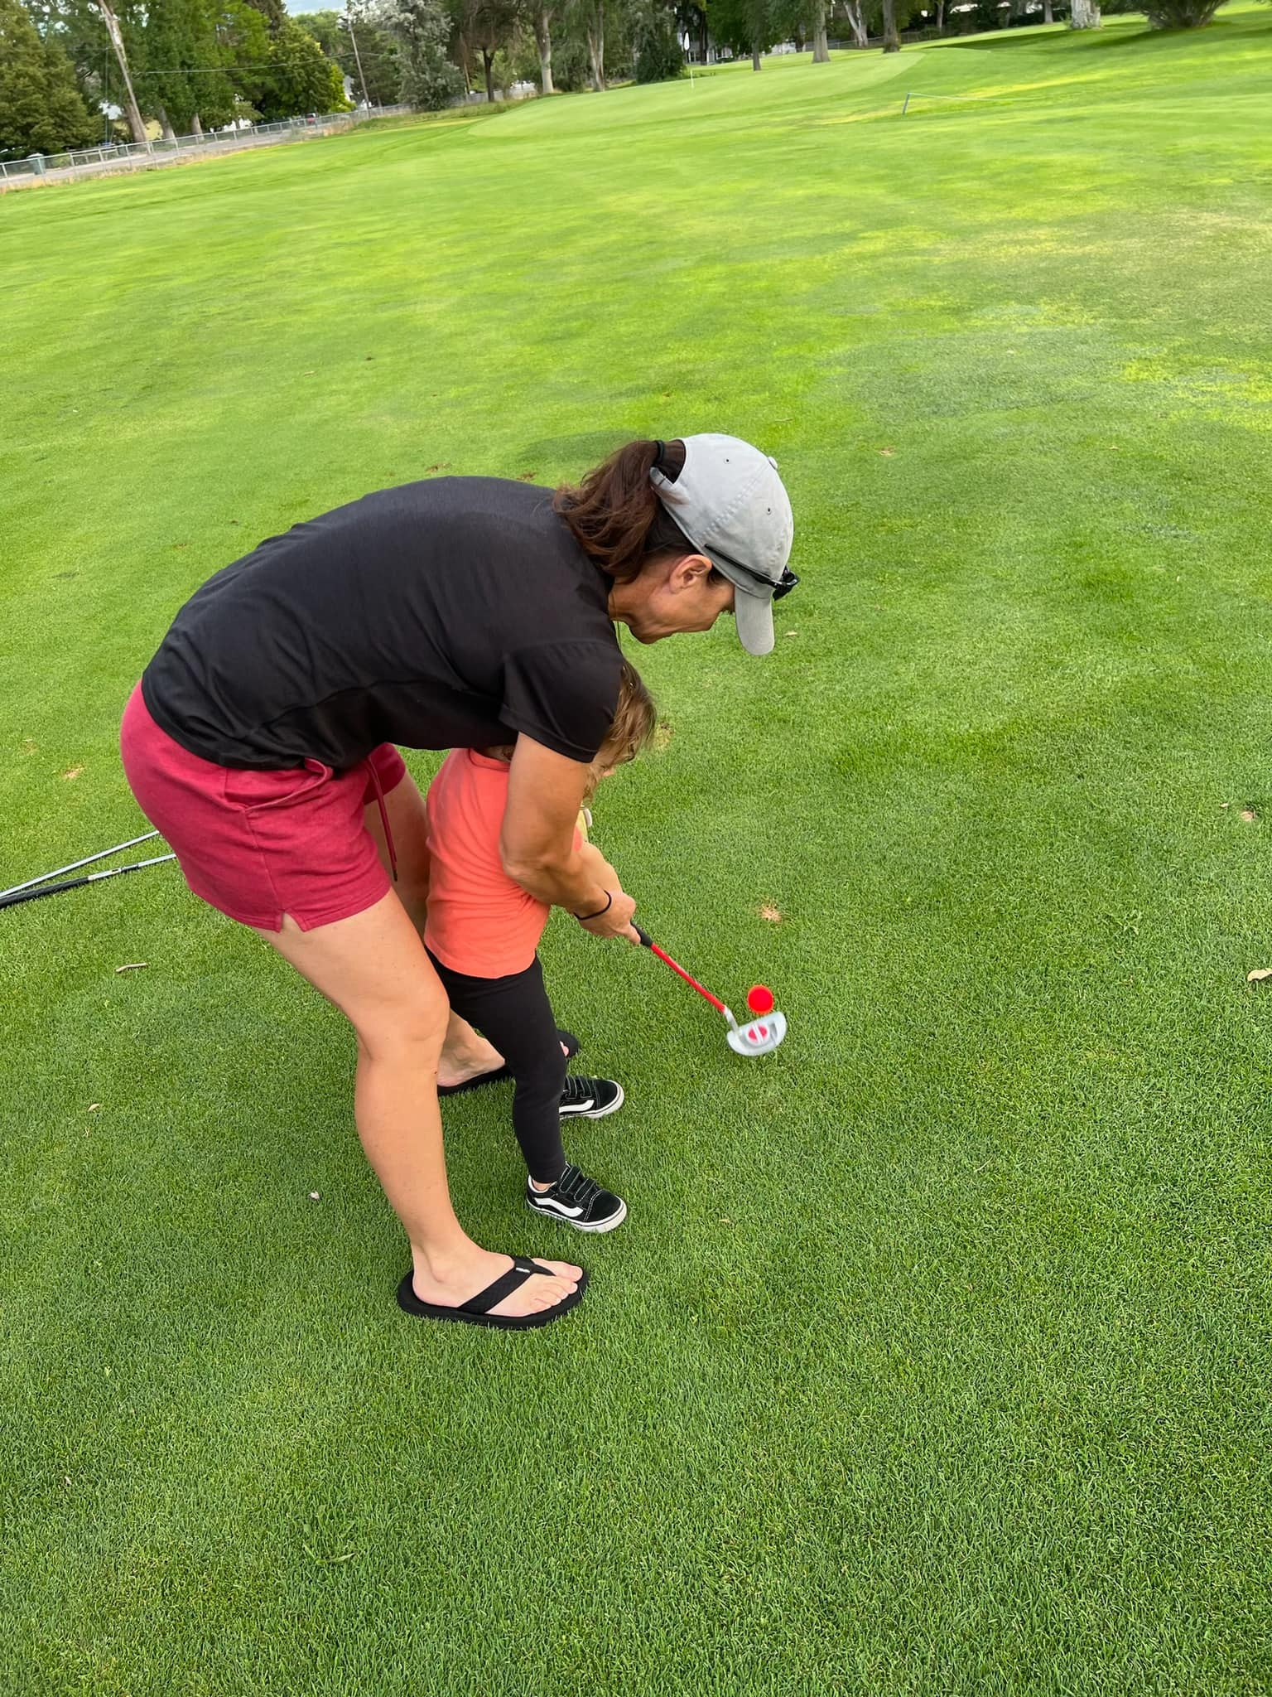
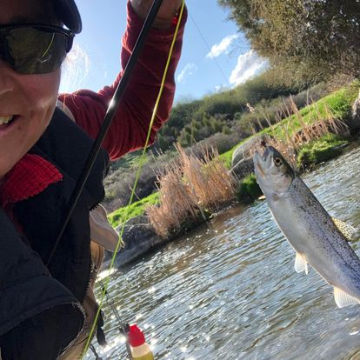


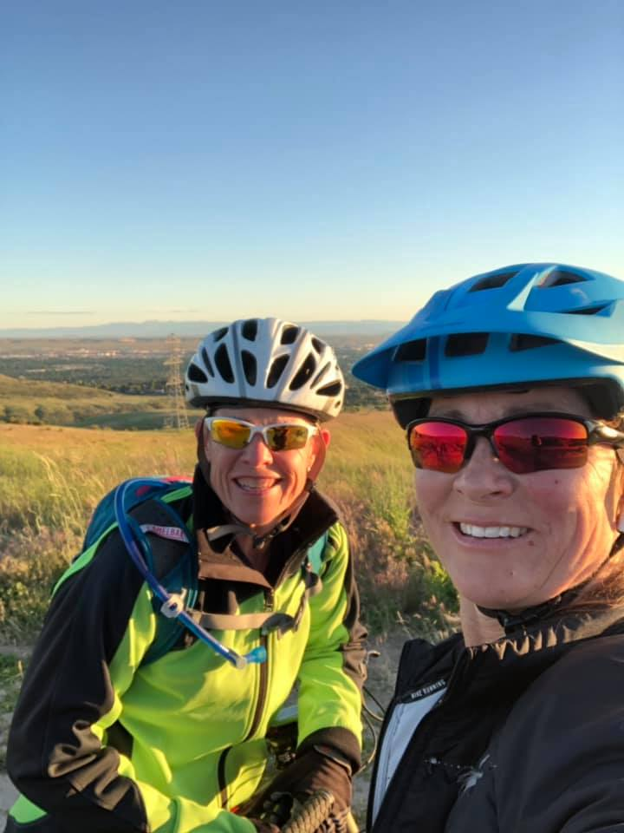


Tonya Wilkes
Director of Student Services and Athletics
1995-2008 Mathematics and Science Educator
2008 -2019 Administrator
2019- Present Director
Wife, parent of 4 and outdoor enthusiast!
PICTURES
Notes:
Toliet paper roll
Lunch lady social media fabrication
Trauma Informed Classroom, MSOYW, restorative practice

Slide 29
Goals for Today:
We all want to be better, do more, and be more. Sometimes we put so much emphasis on improving the external, we forget about our internal selves.
Being resilient and staying strong is just as important for you individually as it is for us as a community.
Our community’s prosperity is reliant on our leaders’ energy and ability to continue leading us into the future.

Slide 30
What prevents you from making your physical and mental health a priority?
What areas of your life would benefit most from improved physical and mental health?
How do your physical and mental health affect your leadership?
CHECK IN

Slide 31
Grab a Role for Today!
Energizer
Summarizer
JOTD (Joke of the Day)
Leader

Slide 32

Have you ever been the person in this story?

Slide 33


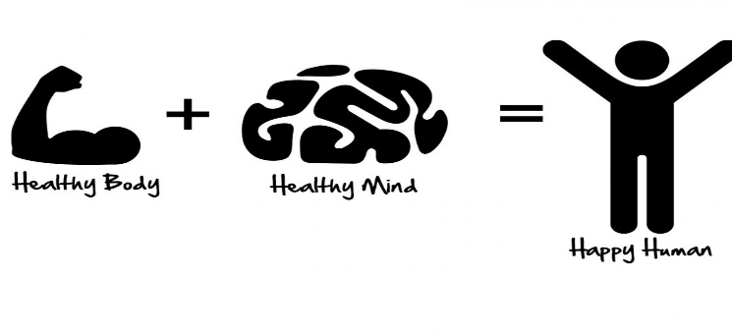
AREAS OF FOCUS: our internal selves
MENTAL HEALTH
          PHYSICAL HEALTH
                OVERALL WELL-BEING
Notes:
Mental Health
A person's emotional, social, and psychological well being, according to U.S. Dept. of Health and Human Resources
Physical Health
The well-being of the body and proper functioning of the organism.
Overall Well-Being
When do you reach your True Happiness

Slide 34

MENTAL HEALTH
A PERSONS EMOTIONAL, SOCIAL, AND PSYCHOLOGICAL WELL BEING, ACCORDING TO U.S. DEPT. OF HEALTH AND HUMAN SERVICES.
Emotional Intelligence is as important as IQ
  Emotional intelligence is defined as the ability to understand and manage your emotions, as well as recognize and influence the emotions of those around you.

Slide 35

WE ALL KNOW SOMEONE
10 MILLION AMERICANS SUFFER FROM MENTAL ILLNESS
1 IN 5 AMERICANS SUFFERS FROM ANY MENTAL ILLNESS AT LEAST ONCE A YEAR
IDAHO IS RANKED 5TH IN NATION FOR ADULTS HAVING MENTAL ILLNESS.. according to Forbes Advisor
Yearly tune up!!!

Slide 36
Emotional Intelligence : 4 skills
1.Self- Awareness
Strategies
2.Self-Management
Strategies
3.Social Awareness
Strategies
4.Relationship Management
Strategies

Slide 37


MESSAGE FROM A LEGEND
Notes:
Was it easy to make a consensus decision in your groups?
What were some of the issues groups had?
Did anyone find their group discussion to be one sided?
In group setting such as this, how can a leader bring the quieter people into the discussion?

Slide 38
Leader
Starting with leader go around table and share out how the video impacted you?
Do you practice Emotional Intelligence?

Slide 39
Relationships/Belonging/Connections
Activity
4 groups (questions)
Notes:
Touch the shoulders of all the people in the room that these statements best fit
You would like to have dinner w/and get to know better
Helped you (even when you didn’t ask)
Has shown you compassion
Has an incredible smile
Been a mentor for you
Demonstrate perseverance
Shows passion for leadership
Go have coffee with this person
Has gone above and beyond what is asked of them
Is very approachable
Always positive
Hard worker
Someone you would love to go on a road trip with
Show determination/dedication
Always been there when asked/needed
Fun-exciting- get into trouble with
Go to a movie with
Always been accountable (be there for you)
Has shown great trust (trust worthy)
Could win leader of the year!!!

Slide 40
Why Happiness?
When you are happy you increase your productivity by 31% , compared to negative, neutral or stressed
When you are happy your intelligence rises, your creativity rises, your energy level rises
Depression rates today are ten times higher than they were in 1960.
Optimistic salespeople outsell their pessimistic counterparts by 56 percent.
Doctors are 19% more accurate when positive.
Whether you think you can achieve or not (either way) you’ll prove yourself right!!
Notes:
Stand up and touch 3 chairs – pick partner “you’re it

Slide 41

Happiness Advantage

Slide 42
Summarizer : YOU MATTER!
What can we do today to help ourselves?
3 Gratitude’s (share through email, conversation, last 24 hours)
Journaling (each night focus on positives in last 24 hours)
Exercise (consistently, routine)
Meditation (15-20 min a day)
Random Acts of Kindness (email, snickers, thank you cards)
Notes:
Tips to creating overall happiness! Find ways to become positive and in the present!
Releasing Dopamine - makes you happy and turns on all the learning centers in your brain

Slide 43

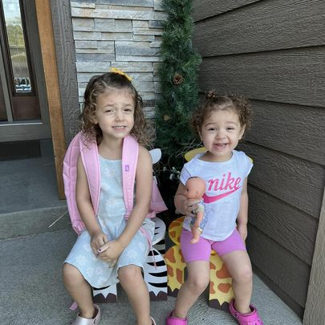

What can we do today as a community to help each other?
ESPN
  Eye Contact
  Smile
  Physical Contact (healthy)
  Name
5/10 Rule
  5 Feet – Say HELLO
  10 Feet - Smile
SMILE
  Serve
  Mentor
  Inspire
  Love
  Encourage
Notes:
7 second stare… ripple the effects of a smile.

Slide 44
JOTD (Joke of The Day!)
Notes:
JOTD - share

Slide 45

PHYSICAL HEALTH
  THE WELL-BEING OF THE BODY AND PROPER FUNCTIONING OF THE ORGANISM
  Yearly doctor visits and dental vists
  Eating properly

Slide 46
COUPLE TIPS
PHYSICAL EXERCISE
IMPROVE MOOD
REDUCE ANXIETY
NORMALIZE SLEEP PATTERNS
MINDFUL MEDITATION
WORKOUT APPS
LEVELS OF EXCERCISE
PLAY
Notes:
Okie dokie

Slide 47
Energizer
Share out with table what you know about exercise and its benefits.
What does exercise look like for you?
“Your problems adjust to their true level of importance after a hard workout and good night of sleep” James Clear (Atomic Habits)
Notes:
Note down how you feel right now?

Slide 48

Overall Wellness
Notes:
Daughter – hike, mtn bike ride, walk, workout at gym… activity.

Slide 49



LIES WE TELL OURSELVES

Slide 50

FOCUS ON POSITIVE MOMENTS
“You are the one who calls the law of attraction into action, and you do it through your thoughts.” – Rhonda Byrne

Slide 51

SURROUND YOURSELF WITH SUPPORTIVE PEOPLE
BETTER COPING SKILLS
LONGER LIFE
REDUCED DEPRESSION
SEEN/HEARD/VALUED
Notes:
If you find yourself answering no to any of these questions, actively practicing them daily will help with your ability to be empathetic to those around you.

Slide 52
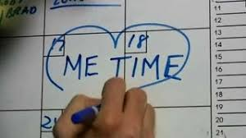
TAKE TIME FOR YOURSELF DAILY
“It is so easy to overestimate the importance of a defining moment and underestimate the value of making small improvements on a daily basis.” James Clear
IMPROVES MENTAL HEALTH
CREATES EMPATHY FOR OTHERS
READ A GOOD BOOK, BOOK CLUB,
BOOK STUDY, WORK COMPETITIONS FOR DAILY GOALS, HIKE, LUNCH, SNICKERS, THANK YOU NOTES, INSPIRATIONAL MOVIE, SEEN/HEARD/VALUED

Slide 53


MESSAGE FROM A LEADER

Slide 54
Resilience – FOCUS ON POSITIVE
Adverse Childhood Experiences (ACE’s)
Positive Childhood Experiences (PCE’s)
Physical, sexual, and emotional abuse.
Emotional and physical neglect.
Living with a family member with mental health or substance use disorders.
Witnessing domestic violence.
Sudden separation from a loved one.
Poverty.
Racism and discrimination.
Violence in the community.
Being able to talk openly to a family member or as a family about feelings and feel heard, accepted and supported.
Belief that family stood by them during difficult times.
Feeling safe and protected by an adult in the home.
Feeling supported by friends.
Having a sense of belonging and connection with a larger group who has “got your back” (e.g. school, church, clubs, neighborhood, etc.).
Enjoyment of participation in community traditions.
Relationship with at least one non-parent adult who takes genuine interest in you.

Slide 55
LEADER CLASS ACTIVITY
Affirmations:
1 read to 3, 2 read to 4
Notes:
Individual

Slide 56

Food Safety: Tools and Best Practices for Success
Jennifer Erickson
Food Safety & Compliance Manager
The Idaho Foodbank

Slide 57

Objectives for Today
Why food safety?
Our Commitment
Food Safety Updates & Review – NEW MANUAL!
Program Manual Highlights
  Federal labeling requirements
  Produce
  Farm Fresh Eggs
  Baby Formula & Baby Food
  Pet Food & Non-food
  Training requirements

Slide 58
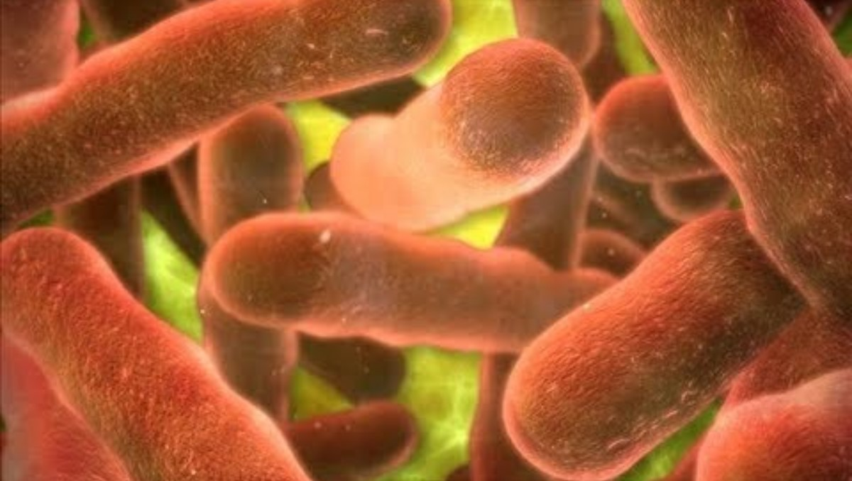
Why food safety?

Slide 59
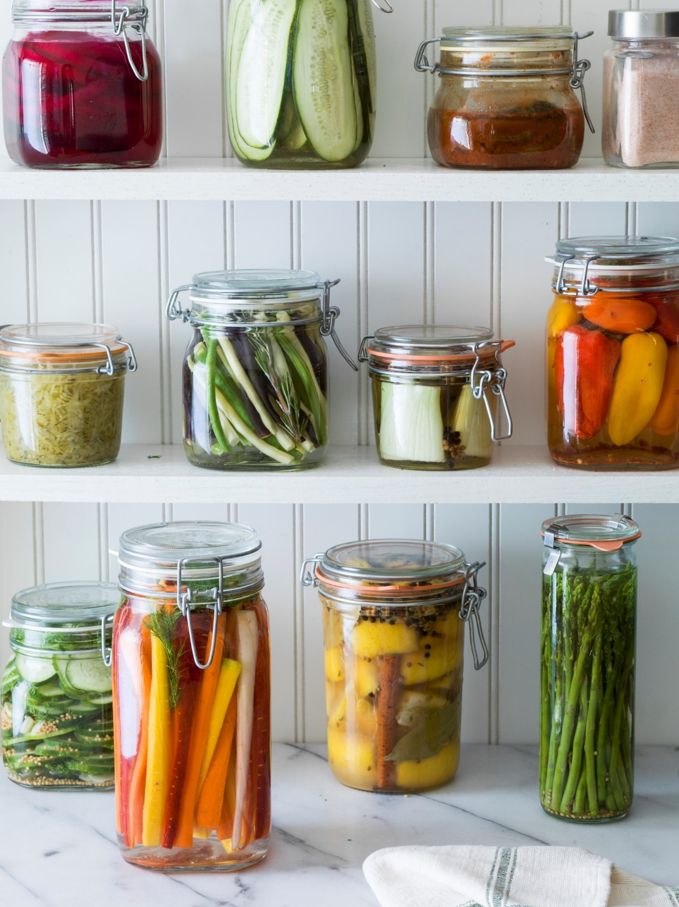
Largest Botulism Outbreak
1977: Trini & Carmen’s hot sauce; Michigan
  58 people ill, 0 deaths
  Source: Improperly home-canned jalapeno peppers
2015: Home-canned potatoes; Ohio
  29 people ill, 1 death
  Improperly home-canned potatoes used to make potato salad for a church potluck picnic

Slide 60
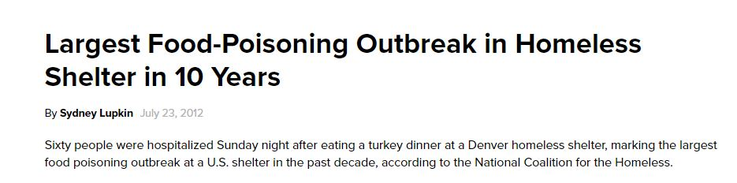
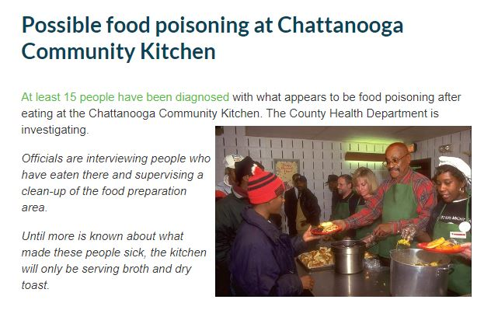
Foodborne Illness & Partners??
“According to a release from the Rescue Mission, the non-profit group conducted an internal investigation this week while waiting for the official results from an ongoing investigation by public health officials.
“We determined that our Lawrence Street Shelter did not follow our established procedures for handling pre-prepared food donations on Sunday, which it often receives,” the release said. “We provide over 600,000 meals annually and are confident this is an isolated incident. Our number one concern is for the poor and needy we serve every day.””
Photo Credit: www.barfblog.com

Slide 61

Our Commitment
Food safety is a top priority for the Neighbors we serve
  High risk populations: elderly, children, immuno-compromised
Food safety requires a shared responsibility for the greatest impact
Protects and promotes a healthy community

Slide 62

Four main factors in foodborne illness
Time/temperature abuse
Cross-contamination
Poor personal hygiene
Poor cleaning & sanitizing

Slide 63
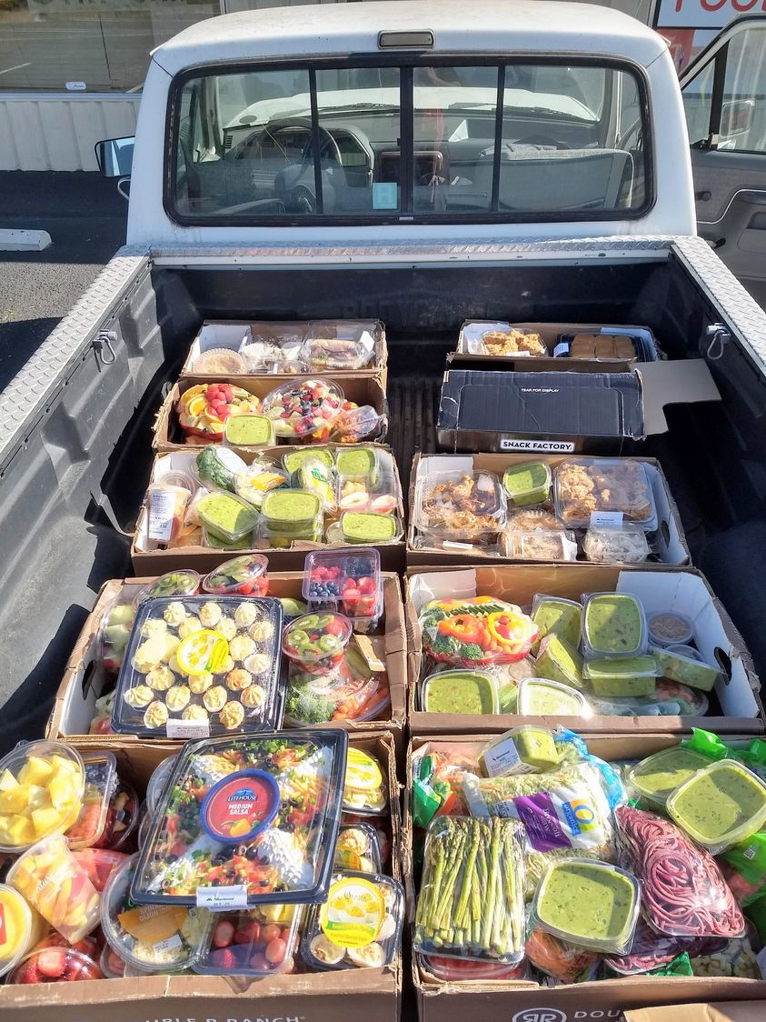
Time/Temperature Abuse
Keep cold foods cold
Use a refrigerated truck or insulated freezer blankets regardless of distance
Adequate coverage
Use year round
Monitor & document temperatures
Leave the pets at home

Slide 64
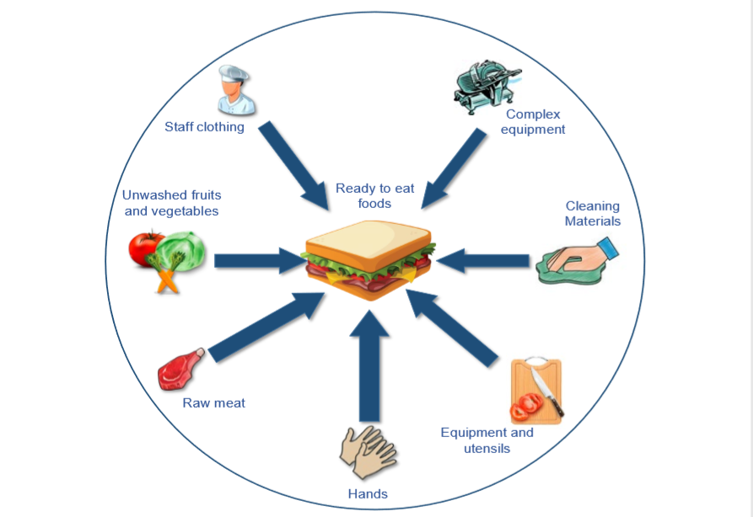
Cross-Contamination
Raw and ready-to-eat foods
Improper food handling
Improper food storage
Contaminated cleaning cloths on food contact surfaces
Also……
Don’t forget cross-contact with allergenic products!
Now the Big Nine

Slide 65

Poor personal hygiene
Do not work when ill
Follow proper handwashing
Sneeze into the crook of your arm
Hand to face contact
  Sneezing
  Coughing

Slide 66

Poor cleaning and sanitizing
Regular cleaning of your facility is important!
Equipment and utensils used in your facility must be washed, rinsed and sanitized in between use
Make sure your sanitizer is working!

Slide 67

Foods Most Likely to Become Unsafe
TCS Foods: food requiring time and temperature control for food safety
“FAT TOM”
Food - Most bacteria need nutrients to survive – TCS foods support the growth of bacteria better than other types of food
Acidity – little or no acid
Temperature
Time – longer time in danger zone
Oxygen
Moisture – high levels

Slide 68

Food Safety is Preventive
A food safety program is built of several prerequisite programs that work together to ensure a solid foundation for safe food
Usually with an outbreak of a foodborne illness, it is a prerequisite program that has failed

Slide 69

The Food Safety Manual for Food Banking
Food safety removed from various partner manuals to ensure complete and current information in a central location
Provides requirements and best practices for food safety
Mirrors our overall food safety program for IFB
Use it as a resource!

Slide 70
Manual Highlights

Slide 71

Federal Retail Labeling Requirements
All food items distributed to our neighbors must be appropriately labeled for retail sale according to The Fair Packaging and Labeling Act (FPLA) – with the exception of whole produce
  Common name
  Name of manufacturer/distributor
  Pack Date
  List of ingredients
  Allergen statement
  Safe handling instructions: meat, poultry, fish/seafood
Failure to distribute properly labeled food?
  Class I Recall
Remember our commitment to our partners!

Slide 72

Fresh Produce
Whole produce does not require labeling
Processed produce must be labeled
Garden produce must be intact – cannot be cut or processed
Examples of cut produce
Temperature requirements
  Whole vs. cut
  Grocery store placement

Slide 73

Farm Fresh Eggs
Egg carton must be clearly marked with “Ungraded” or grading blacked out
Carton must bear the name and address of Idaho egg producer
Eggs must be kept refrigerated at 45ᵒF or below
Ensure eggs were refrigerated at 45ᵒF or below within one month of being laid

Slide 74

Baby Formula & Baby Food
Baby formula must be destroyed upon date of expiration
Baby food for early stage development should be destroyed upon the expiration date (e.g. cereals)
Baby food items for later stages of development can use an extended date, with the understanding that the nutritional value of the product could be slightly reduced and not match the labeling claim
  Approximately two months beyond marked date

Slide 75

Pet Food & Non-Food Items
Pet food is NOT a food safety hazard unless opened
Store separately from human food
Non-food items should be segregated from human food and always stored separately or underneath food items
  Personal care items
  Household cleaning items

Slide 76

Food Safety Training
How do you know you are doing the right thing?
Where do you receive your information from to stay current?

Slide 77

CFPM Training
Having the highest level of training you can demonstrates to those you serve your commitment and assurance that they are receiving safe and wholesome food
We uphold the trust placed in us to provide not just sustenance, but safety and respect for all involved.
Feed with dignity

Slide 78

What is Needed
Person in Charge (TCS Foods): Food Protection Manager
Staff & Volunteers of TCS Foods: Food Handler for Foodbanking
Drivers of Food Rescue: Food Handler for Foodbanking
All other food handling volunteers: Basic food safety training
Grant opportunity?

Slide 79

Questions?
Jennifer Erickson
jerickson@idahofoodbank.org
(208) 577-2725

